Slide 1
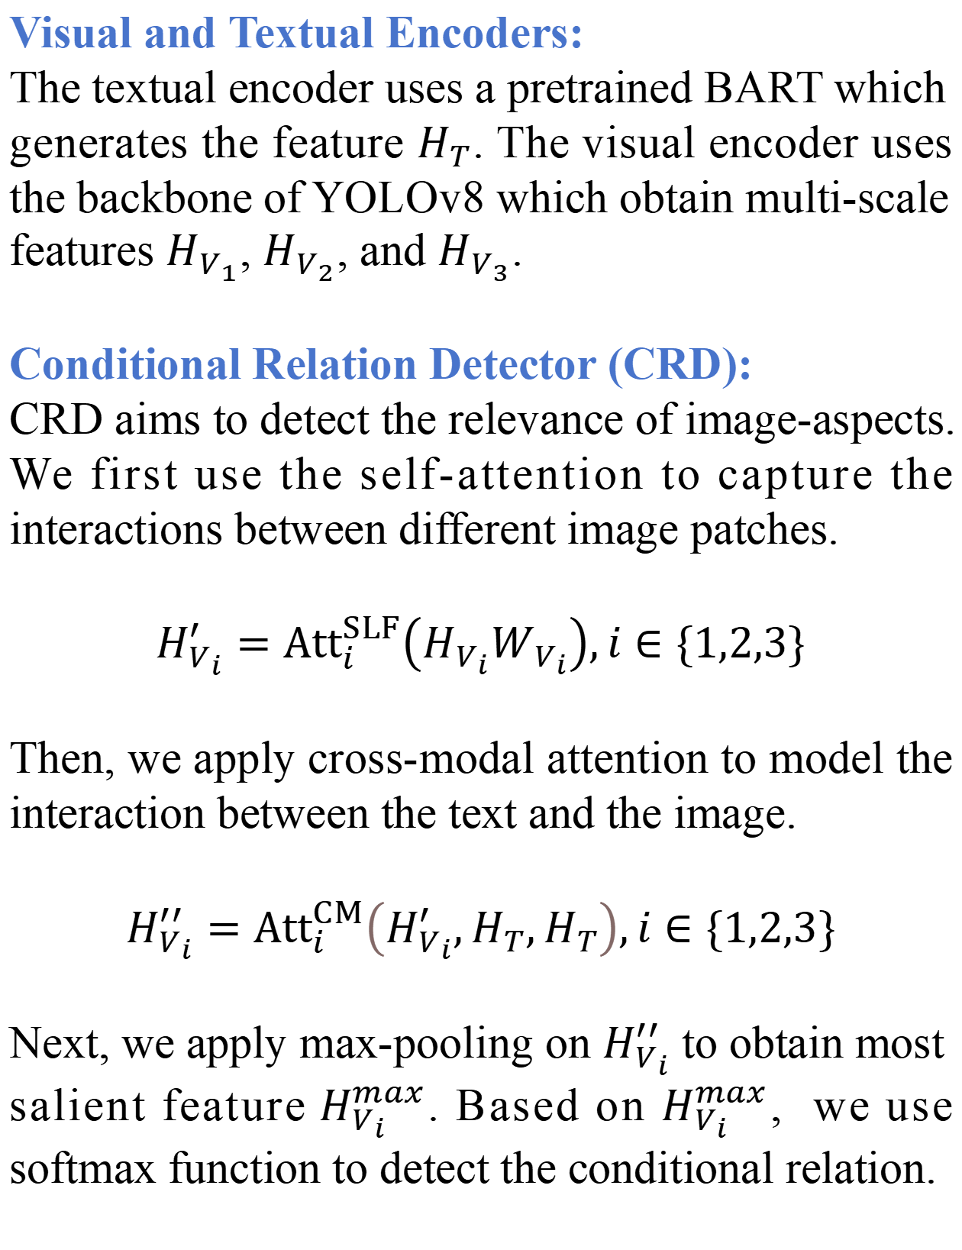





Multimodal Aspect-Based Sentiment Analysis under Conditional Relation
Xinjing Liu, Ruifan Li*, Shuqin Ye, Guangwei Zhang, Xiaojie Wang
liuxj_ai, rfli, shuqinye, gwzhang, xjwang@bupt.edu.cn
1. Introduction
MABSA Task: Multimodal Aspect-Based Sentiment Analysis (MABSA) includes three key subtasks: Multimodal Aspect Term Extraction (MATE), Multimodal Aspect-oriented Sentiment Classification (MASC), and Joint Multimodal Aspects of Sentiment Analysis (JMASA). MATE aims to extract all the aspect terms mentioned in the text; MASC aims to determine the sentiment towards each given aspect term. JMASA aims to jointly predict the aspect terms and the corresponding sentiments.
Contributions:
We propose a multi-task framework, CORSA for MABSA task, involving a detector and a localizer. A conditional relation detector (CRD) mitigates the impact of the unmet conditional image-text; A visual object localizer (VOL) locates the exact condition-related visual regions referred by the aspects.
We perform two types of annotations, conditional relation and bounding boxes on TWITTER-15 and TWITTER-17 datasets.
We conduct extensive experiments on two benchmark datasets. The results show the effectiveness of our proposed CORSA model.
Problems: Previous methods are based on the premise that the image contains the objects referred by the aspects within the text. However, this condition cannot always be met.
2. Data Generation for C-MABSA
3. Our Proposed Model
$${\hat{r}}_{i}=Softmax\left(W_{R_{i}}H_{V_{i}}^{max}+b_{R_{i}}\right)$$
Finally, we filter the visual features most relevant to aspects by a visual filter matrix $G_{i}$, where each entry equals to the probability ${\hat{r}}_{i}$. Thus, we obtain $H_{V_{i}}^{′′′}$ i.e.,
$$H_{V_{i}}^{′′′}=G_{i}⊙H_{V_{i}}^{′′},i∈\{1,2,3\}$$
We construct datasets, i.e., C-MABSA with co-nditional relations for MABSA task. Specifically, we perform two types of annotations autom-atically on two popular datasets, i.e., TWITTER-15 and TWITTER-17.
Visual Object Localizer (VOL):
VOL aims to further enhance CR-D and then localize the exact con-dition-related region. We detect visual objects with the previously fi-
We firstly use a pretrained multi-task univer-sal instance perception model, UNINEXT to annotate the conditional relation. UNINEXT takes an aspect and the corresponding image as input and then generates the probability that the image contains the aspect. For samples with more than one aspect, we average the multiple output probabilities. For TWITTER-15, when this probability exceeds a threshold $τ_{1}$ of 0.7, we annotate the conditional relation as relevant. For TWITTER-17, the threshold $τ_{1}$ is set as 0.5 to keep more visual information.
Visual and Textual Encoders:
The textual encoder uses a pretrained BART which generates the feature $H_{T}$. The visual encoder uses the backbone of YOLOv8 which obtain multi-scale features $H_{V_{1}}$, $H_{V_{2}}$, and $H_{V_{3}}$.
Conditional Relation Detector (CRD):
CRD aims to detect the relevance of image-aspects. We first use the self-attention to capture the interactions between different image patches.
$$H_{V_{i}}^{′}={Att}_{i}^{SLF}\left(H_{V_{i}}W_{V_{i}}\right),i∈\{1,2,3\}$$
Then, we apply cross-modal attention to model the interaction between the text and the image.
$$H_{V_{i}}^{′′}={Att}_{i}^{CM}\left(H_{V_{i}}^{′},H_{T},H_{T}\right),i∈\{1,2,3\}$$
Next, we apply max-pooling on $H_{V_{i}}^{′′}$ to obtain most salient feature$H_{V_{i}}^{max}$. Based on $H_{V_{i}}^{max}$, we use softmax function to detect the conditional relation.
ltered feature $H_{V_{i}}^{′′′}$ as input, and the output is the category and bounding box of the visual object.
$$O_{i}=DET\left(H_{V_{i}}^{′′′}\right),i∈\{1,2,3\}$$
Then, we utilize cross-model attention to align visual objects and aspects, where $H_{T}^{A}$ is the feature of the noun phrases extracted by Spacy.
$$H_{V_{i}}^{A}={Att}_{i}^{CM}\left(H_{V_{i}}^{′′′},H_{T}^{A},H_{T}^{A}\right),i∈\{1,2,3\}$$
Finally, we use gating mechanism to concatenate two visual features $H_{V_{i}}^{A}$ and $H_{V_{i}}^{′′′}$.
Multi-modal Sentiment Analyzer (MSA):
We use the multimodal BART encoder-decoder to predict the aspects and their sentiment $y_{t}$,
$$\left.\left\{\begin{matrix}{\hat{H}}^{′′′}=Encoder\left({\hat{H}}^{′′}⊕E\right) \\ h_{t}=Decoder\left({\hat{H}}^{′′′};Y_{<t}\right) \\ y_{t}=Softmax\left(W_{t}h_{t}+b_{t}\right)\end{matrix}\right.\right.$$
Secondly, we use an object detection model YOLOv8 pretrained on MSCOCO to annotate the visual objects in the image, including the bounding boxes and categories. For the object category, we define three types, including person, object, and background. If the probability exceeds the threshold $τ_{2}$ of 0.8, we annotate the image as person or object; otherwise, we annotate it as a background category. Here, the bounding box is taken as the image size.
Comparison on JMASA task:
4. Experimental Results
Case study:
Comparison with MLLM:

